Slide 1
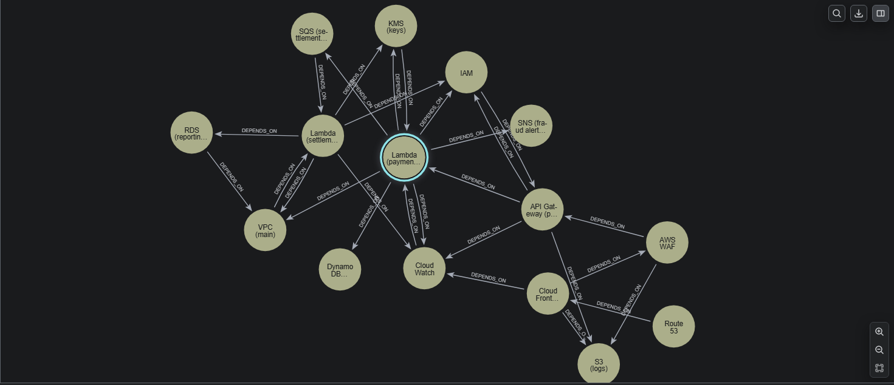
KNOWLEDGE GRAPHS FOR SYSTEM INTEGRATION RISK
Name - Gunjan Rawat

Slide 2
CONTENT
Pipeline
Methodology
Results
Conclusion

Slide 3
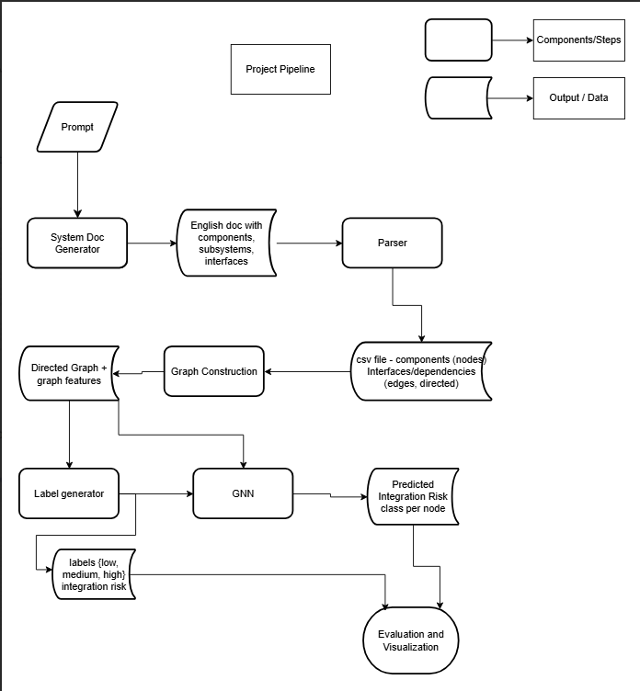
Pipeline

Slide 4
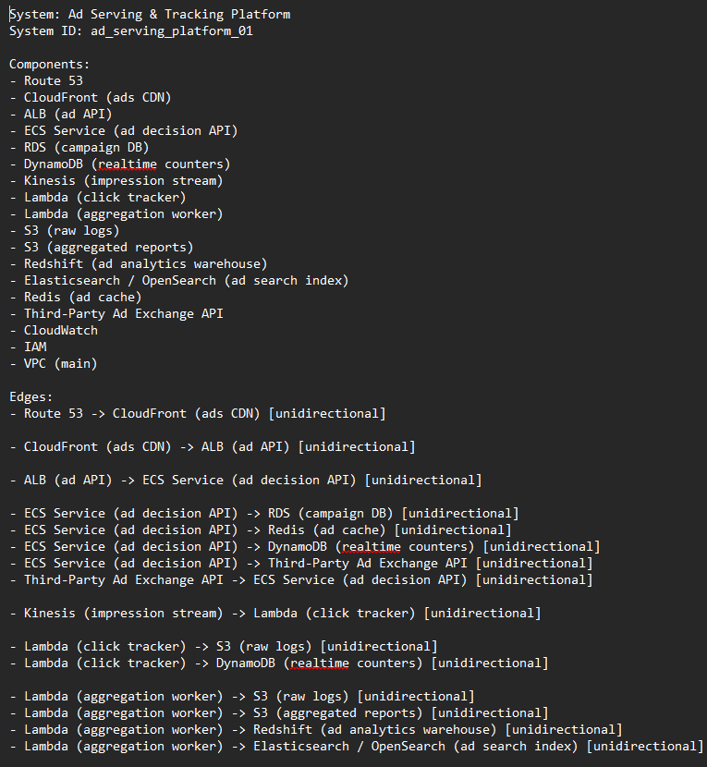
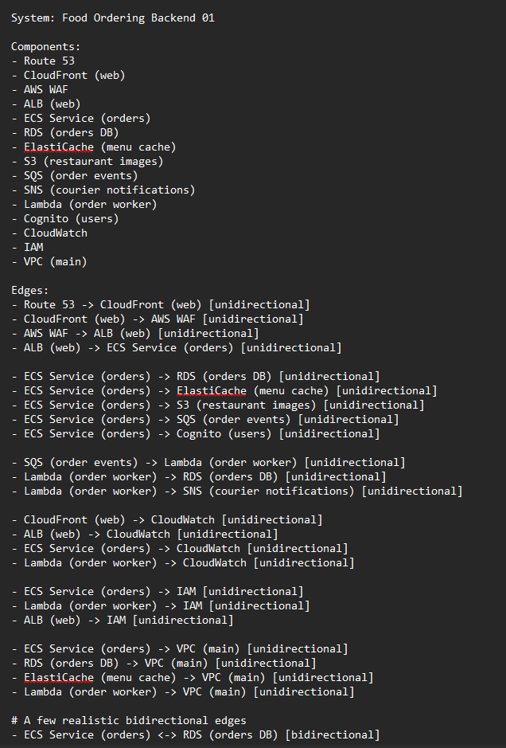
System Generation

Slide 5
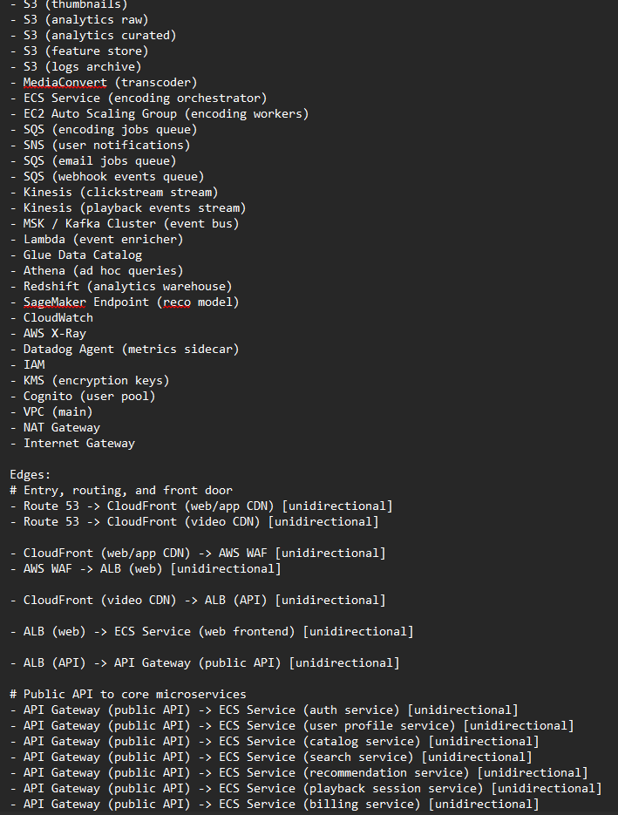
System Generation - Main System
Main System - 60 + Components and 100 + Edges -
Trained GCN will predict risk labels for this system

Slide 6
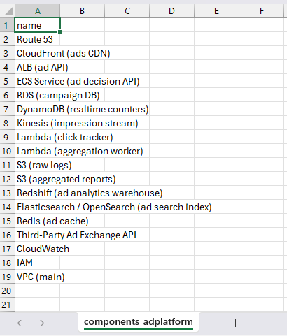
Parsing and CSV Extraction
Components.csv
Each row represents a node

Slide 7
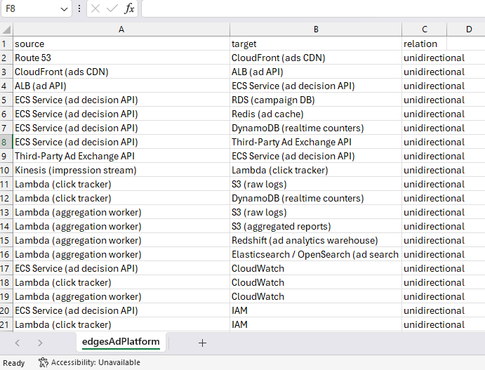
Parsing and CSV Extraction
Edges.csv -
Each row represents a direct relation between 2 components (nodes)

Slide 8
Graph Construction and Feature Engineering
1. Degree-Based Metrics - Help identify how “busy” or central a component is in terms of direct connections.
In-Degree — number of incoming dependencies
Out-Degree — number of outgoing dependencies
Total Degree — overall connectivity of the node
2. Centrality Measures - Capture how influential a component is in the overall flow of the system.
Betweenness Centrality — how often a node lies on shortest paths
Closeness Centrality — how close a node is to al
Eigenvector Centrality — influence based on connections to other important nodes
PageRank — probability of arriving at a node via random traversal
3. Reachability Metrics - Describe how failures propagate through the graph.
Downstream Count — number of components that depend (directly or indirectly) on this node
Upstream Count — number of components this node depends on
4. Structural Criticality (Articulation Points) -Highlights nodes whose removal would break the system’s connectivity.
Articulation Status — whether the node disconnects parts of the graph if removed

Slide 9
Heuristic Risk Labelling
Importance Score Formula :
importance_score=0.4(degree)+0.4(betweenness)+0.4(downstream)+0.2(articulation)
What it captures :
Local connectivity
Global influence
Blast radius (failure spread)
Structural criticality
Risk Class Assignment :
Compute 33% and 66% quantiles
High risk: score ≥ q_high
Low risk: score ≤ q_low
Medium risk: everything in between

Slide 10
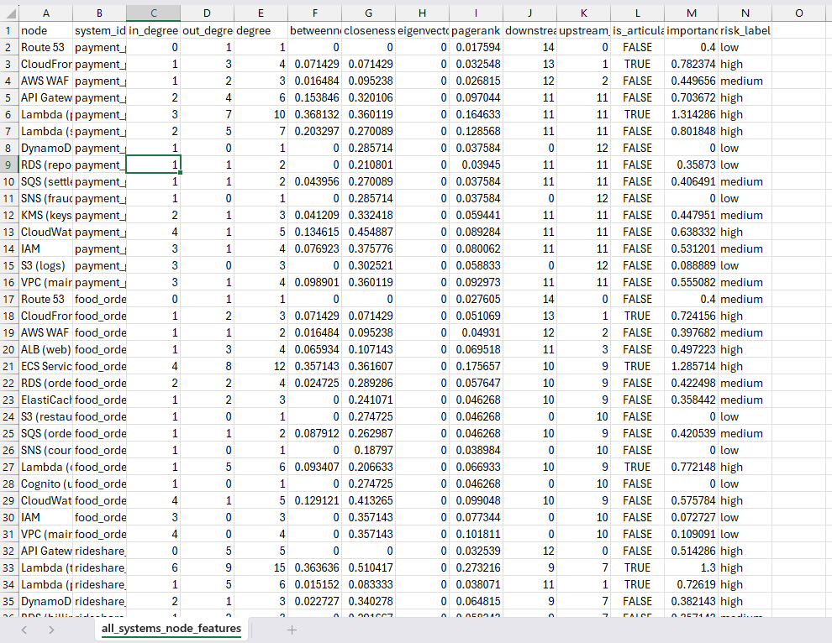
Node Features

Slide 11
GNN Architecture and Training Setup
RiskGCN Model
2× GCNConv layers
ReLU activations
Final Linear classifier → 3 risk classes
Training Strategy -
System-level split:
– 8 systems for training
– 4 unseen systems for validation
Optimization:
– 200 epochs
– Adam (LR = 5e-3, weight decay = 5e-4)
– Cross-entropy loss over all nodes

Slide 12
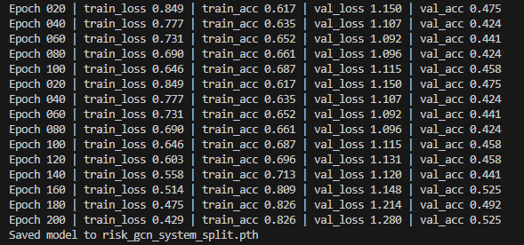
Training and Validation Results
Training loss decreases steadily
Training accuracy reaches 82 %
Validation accuracy stabilizes around 45-52%

Slide 13
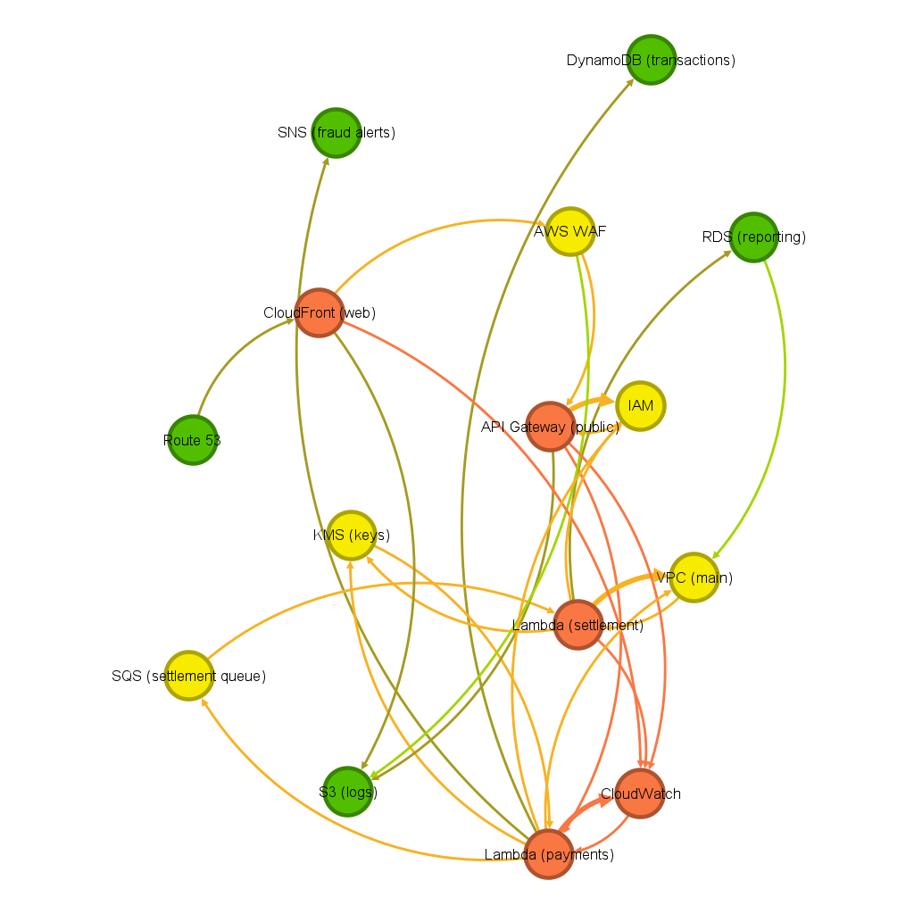
Results - Visualisations
Heuristic labels on payment gateway system

Slide 14
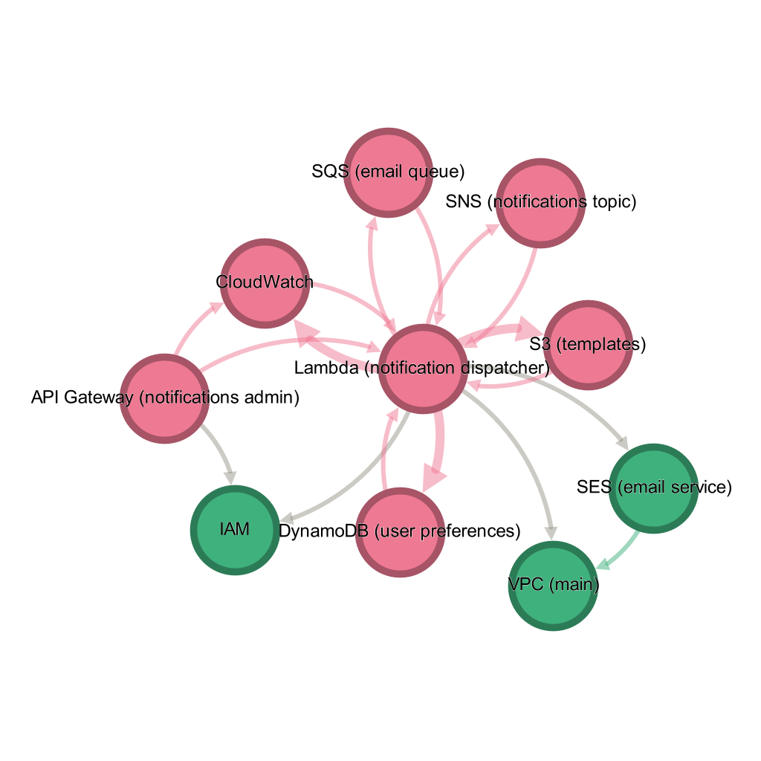
Results - Visualisations
Heuristic labels on notification service system

Slide 15
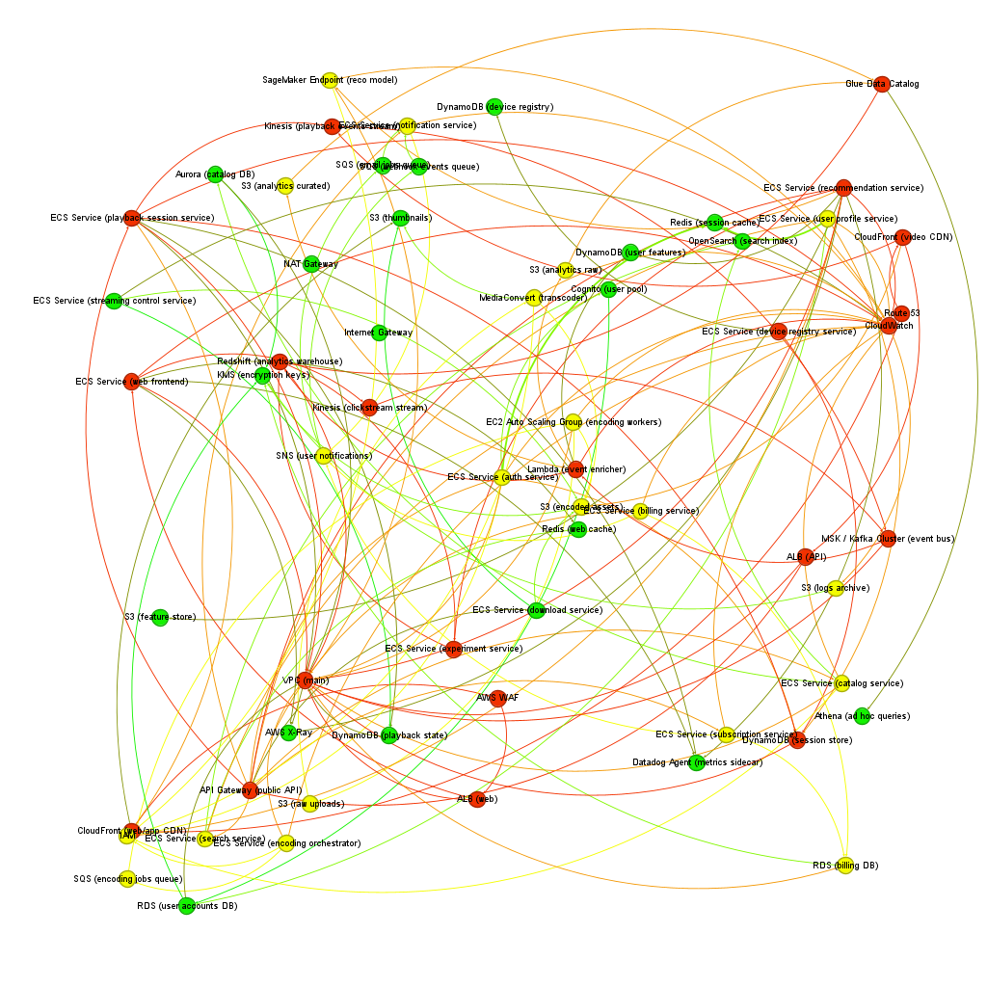
Results - Visualisations
Heuristic labels on the main system
Too many high risk nodes

Slide 16
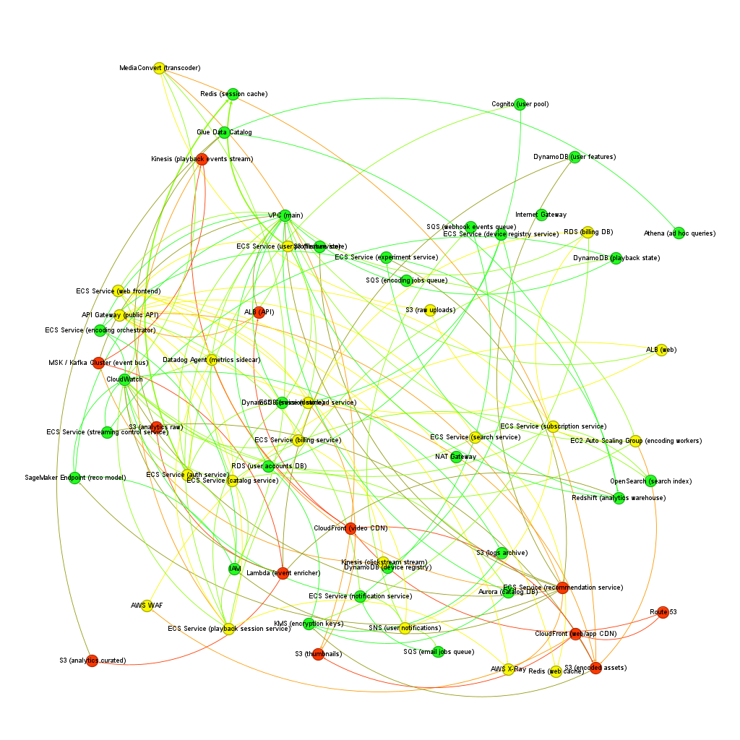
Results - Visualisations
Predicted labels on Main system
Selective with high risk nodes

Slide 17
Results - Comparison
Heuristic labels are noisy, marking many nodes as high-risk even when their role is minor.
GNN predictions are more selective, highlighting only structurally important components.
Predicted graph looks smoother and more interpretable, with clearer separation between low-, medium-, and high-risk areas.
Model aligns better with system intuition, elevating core services (compute, storage) rather than peripheral ones.

Slide 18
Results - Future Scope
Expanding the dataset - more systems, more variation
Including edge features = data flow vs control flow, internal traffic, third party API calls
Making node features more semantic with semantic categories -
Databases
Compute units
Caches
Messaging layers

Slide 19
Results - Conclusion
Created a complete end to end pipeline
GNN provided clearer, more realistic risk assessments
Further improvements in dataset diversity, labelling quality for future scope

Slide 20
THANK YOU !
Name - Gunjan Rawat

